Slide 1
Food Export Association of the Midwest USA
﻿Grow Nebraska Webinar
Notes:
95% of consumers are… outside of the US!
Diversification of Market Risk + Opportunity
Extend life of product, development costs
Capitalize on USA Brand
Use idle capacity; reduce unit costs

Slide 2
Why Export?
95% of consumers are… outside of the US!
Diversification of Market Risk + Opportunity
Extend life of product, development costs
Capitalize on USA Brand
Use idle capacity; reduce unit costs
Grown in the U.S
Exported Worldwide
﻿
Notes:
How many of you are currently exporting?
How many of you are familiar with our organization?

Slide 3
Food Export Association of the Midwest USA: About Us
Who: Private, non-profit international trade organization
Mission: to promote the export of Midwestern food and agriculture products through our programs and services
Members: Our Members are State Agricultural Promotion Agencies;
Assist with Outreach and Promotion
Exporters: small and medium-sized US producers throughout the Midwest
Products contain at least 50% U.S. agricultural content, by weight
Partners:
Members: 12 Midwestern state agricultural export promotion agencies
Strategic Alliance with Food Export USA – Northeast since 2001
Funding from USDA – Foreign Agricultural Service
﻿
Notes:
Benefits of Strategic Alliance:
Similar tactics in complementary markets, we have doubled the number of market opportunities
Increase in overseas representative network
Collaborative programs allow more and larger projects
Program/operational efficiencies and cost savings
More streamlined image for our overseas customers

Slide 4
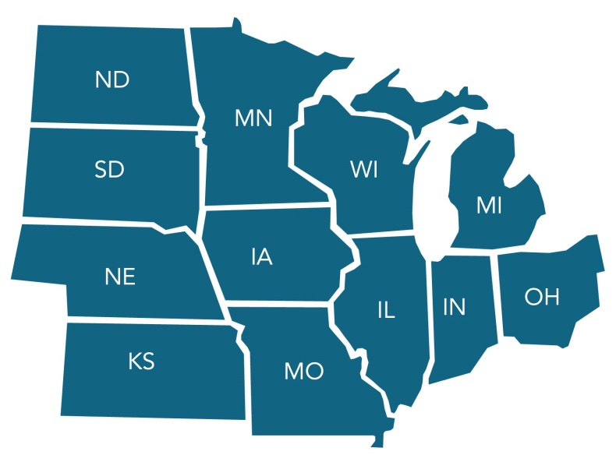
Our Midwest Member States
Illinois Department of Agriculture
Indiana State Department of Agriculture
Iowa Economic Development Authority
Kansas Department of Agriculture
Michigan Department of Agriculture and Rural Development
Minnesota Department of Agriculture
Missouri Department of Agriculture
Nebraska Department of Agriculture
North Dakota Department of Agriculture
Ohio Development Services Agency
South Dakota Department of Agriculture
Wisconsin Department of Agriculture, Trade and Consumer Protection
Notes:
Additional partnerships with trade centers including:
Maine International Trade Center
Empire State Development in New York State
New Hampshire International Trade Resource Center
Rhode Island Commerce
Partnerships and outreach to other agencies is key to our strategy and reaching potential exporters. That’s why I am here today!

Slide 5
MAP – FAS – USDA
Food Export – Midwest is funded by
the U.S. Congress through the
Market Access Program (MAP)
Which is administered by the
Foreign Agricultural Service (FAS)
Which is an agency of the
United States Department Of
Agriculture (USDA)
﻿

Slide 6
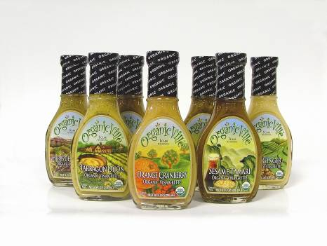
Processed & Value-Added Products
Focus on products that are value-added, consumer-oriented
Branded food products
Snack Food
Convenience Food
Natural Products
Specialty Foods
Private Label
Food Ingredients
Foodservice Products
Feed Ingredients
Other Value-Added Agricultural Products
Notes:
Consumer Oriented – think of what you’d see at a grocery store of what a restaurant would purchase from their distributor

Slide 7
Programs and Services
Providing Midwest agri-business companies the services they need to achieve export success focused on:
Outreach & Exporter Education
Market Entry
Market Promotion

Slide 8
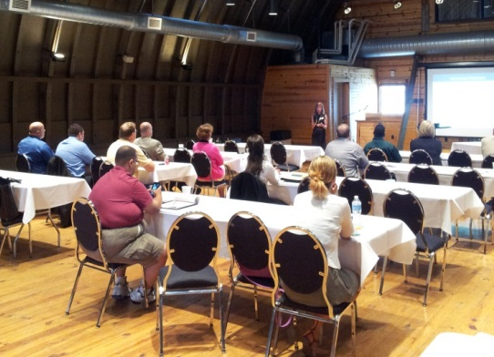
Outreach & Exporter Education
Food Export HelplineTM
Export Advisor Program
Export Essentials Online
Seminars & Webinars
www.Foodexport.org
Newsletters
Notes:
As other organization we have newsletters and website that has industry knowledge targeted to small food manufacturers

Slide 9
Food Export HelplineTM
Provides customized, one-on-one assistance to suppliers
Short-term or long-term support
Industry expert provides assistance
Notes:
Whether you’re new to exporting or have experience there are always specific issues and questions that are unique to your company, products, and export markets. With the Food Export HelplineTM, you’ll speak with an industry expert who’ll put more than 33 years of experience to work for you. There are no canned answers, only insightful, customized advice specifically for you

Slide 10
Food Export HelplineTM
Provides assistance on a variety of topics:
Export readiness
NAFTA rules and regulations
Top Market/Product Evaluation
Secondary market research
Trade event preparation
Documentation and correspondence
Payment and collections
and many more
*Participation agreement is needed
Notes:
Does my product have any potential in other countries?
What are the best markets for my product?
Where can I get good market research?
What steps can I take to find qualified buyers and
business partners?
How do I write an effective letter of introduction to
potential distributors?
What is an Incoterm?
How can I arrive at a competitive export price?
What is a Schedule B number?
Experienced
op Product/Market Evaluation for your products
Tradeshow event preparation
Trade lead follow-up assistance
Calculating export prices based on terms of sale
Commercial documentation & correspondence
Free Trade Agreement (FTA) compliance procedures
Documentary credits & collections
Export assistance provider referrals
Secondary market research
Calculating Destination Duties & Taxes

Slide 11
Educational Seminars and Webinars
In collaboration with our member states
Food Export Helpline Counselor often participates
Among the topics covered
Overseas opportunities and challenges, market specific
Step-by-step breakdown of export transactions
Our programs and services
We also host a variety of Export Webinars
at no cost

Slide 12
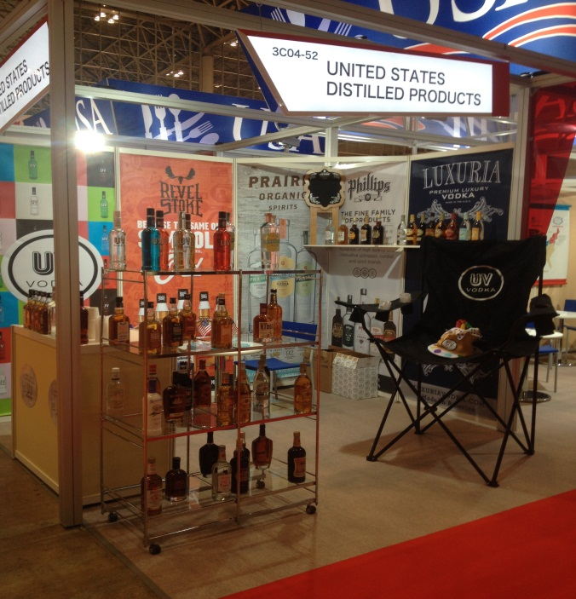
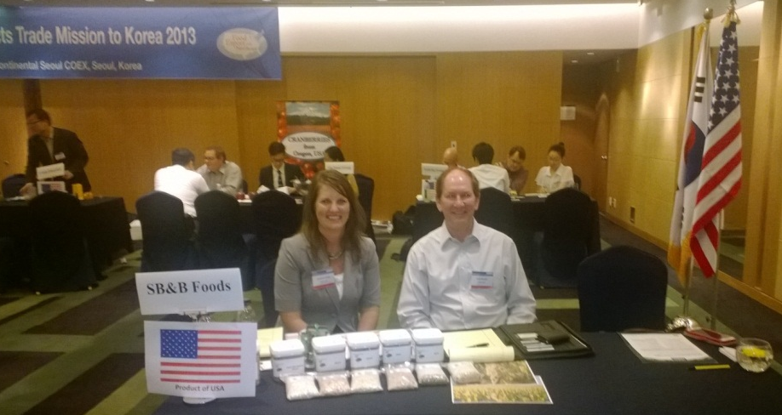
Market Entry
Buyers Missions
Food Show PLUS!TM
Focused Trade Missions
Market Builder
Online Product Catalog

Slide 13
In-Market Representatives
Brazil
Chile
China
Colombia
Hong Kong/Macau
India
Japan
Korea
Mexico
Southeast Asia
Taiwan
Vietnam
Canada
Caribbean
Costa Rica
France
Germany
Guatemala
United Kingdom
Middle East
﻿
Notes:
Food Export could not operate with out our in-market representatives. The IMRs are industry specialists and collectively cover 40+ markets.
In-market reps assist with trade missions in their regions and nominating buyers to come to U.S. for Buyers Missions
Additionally, IMRs complete research for specific products in their market for Food Export’s Market Builder Service
They also remain up to date on documentation, labeling requirements

Slide 14
Market Builder Services
Custom Market Intelligence
Comprehensive services
Market Scan
Rep Finder
Helps companies understand product potential
Assists companies with making and solidifying
market contacts
Assists companies in determining strategic plan
Notes:
Finding the right market and buyer for your product is the key to exporting success! Exporters who are looking to secure their product in an international market, find new distributors or importers, and/or receive valuable feedback about their product can take advantage of our Market Builder service. This one-of-a-kind service offers packages especially designed to an exporter's needs and wants.

Slide 15
Food Show PLUS!TM
Services provided to international tradeshow exhibitors
In-market briefing and local industry tours
Pre-show product research – pricing, import regulations, competitor analysis
Targeted invitation of qualified buyers to exhibitor booths and setting appointments
Translation of exhibitor material for show visitors
On-site show assistance by local In-market representative
Provides technical interpreters at the show booth
Qualifying leads from the show and conducting checks on the top few
Writing and sending a generic follow-up letter in the local language to all contacts

Slide 16
Buyers Missions
International Buyers Here at Home
Brings buyers from target countries to US
One-on-one meetings with buyers and suppliers
Usually in conjunction with a tradeshow

Slide 17
Focused Trade Missions
Total Market Immersion
A three-day activity to bring companies to various countries
Essential tools provided throughout the mission
Briefings, market tours and meetings with Buyers

Slide 18
Market Promotion
Retail & Foodservice Promotions
Branded Program: Cost-share assistance
50% reimbursement of eligible export
marketing expenses
Must be a small business by SBA guidelines
Application and claims process
5 years of funding per country

Slide 19
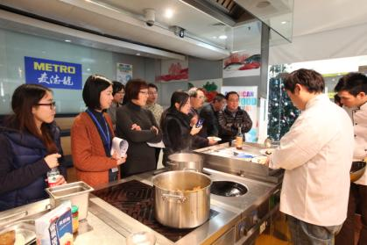
Branded Program
Branded Program Eligible Expenses
Advertising, publications
International Trade Shows
Promotions & demonstrations
Public relations and seminars
Notes:
Branded:
-2500 – 300,000
-Must be a small business by SBA standards
-Application and claims process
-Tradeshows, advertisements, label modifications, sample shipping, promotions, website dev.

Slide 20
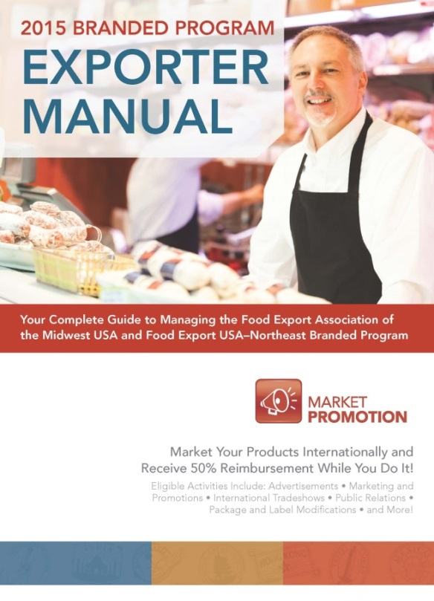
Branded Program
Branded Program Eligible Expenses (continued)
Package and foreign compliant labeling
Freight costs for samples
International Websites
Social Media

Slide 21
Branded Program: Additional Requirements
Activities approved in advance
Company incurs all expenses up front
USA Origin Statement for ALL products, activities, and materials
Made in …
Product of …
Grown in …
US, USA, America or State
name can be used
Notes:
Branded:
-2500 – 300,000
-Must be a small business by SBA standards
-Application and claims process
-Tradeshows, advertisements, label modifications, sample shipping, promotions, website dev.

Slide 22
Branded Program: Reimbursements
Maximum request is $300,000
Minimum request is $2,500
First-time applicants
- With exporting experience, initial maximum request is $50,000
- Without exporting experience, initial maximum request is $25,000
$250 application fee
non-refundable
6% administrative fee
non-refundable
based on approved allocation
Maximum/Minimum requests are based on the reimbursement amount

Slide 23
Branded Program: Program Year Information
Year runs from January 1 - December 31 (Online application opens August 1of previous year)
Expenses must be concluded and paid for prior to December 31
Final deadline for reimbursement requests is February 28
Company evaluations are due February 28
﻿

Slide 24
Your Food Export Liaison
Paul Weiss
pweiss@foodexport.org
312.334.9221

Slide 25
Thank You!
Question & Answer

